Slide 1
TASK 3 Song Analysis Presenter : Youssef Khalid

Slide 2
Technologies

Slide 3
Technologies
I used Power Bi to Create an interactive report to show the following:
EDA of the like count, comment count and view count using box and whiskers diagram
Content and channel analysis
Temporal trends
User engagement insights

Slide 4
Data Cleaning

Slide 5
Data Cleaning
To clean data I did the following:
Transform duration into minutes
Dates into years
Remove empty fields in all columns
Remove video Id column

Slide 6
Observations

Slide 7
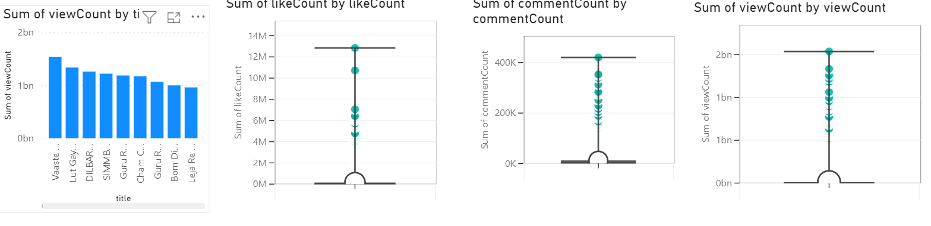
EDA
Here we can see that there is no outliers in the data
We can clearly see the average ,maximum and minimum values for each category
We can also see the most viewed song if we click on the first column in data

Slide 8
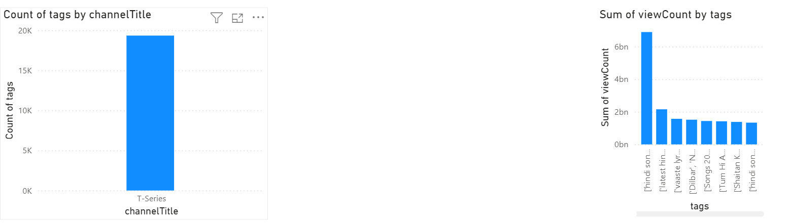
Content and Channel Analysis
We have a single channel in the dataset called T-series and most of its videos are music videos
The most popular tag is Indian music

Slide 9
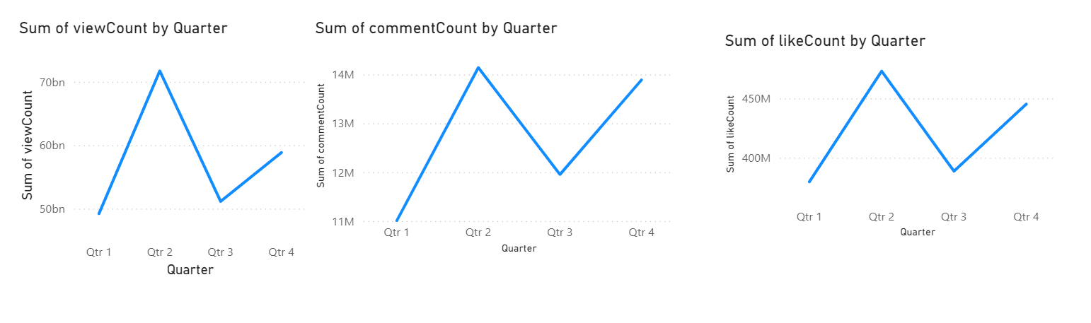
Temporal Trends
Its clear here that the second quarter of the year is when the peak of views ,comments and likes occure

Slide 10
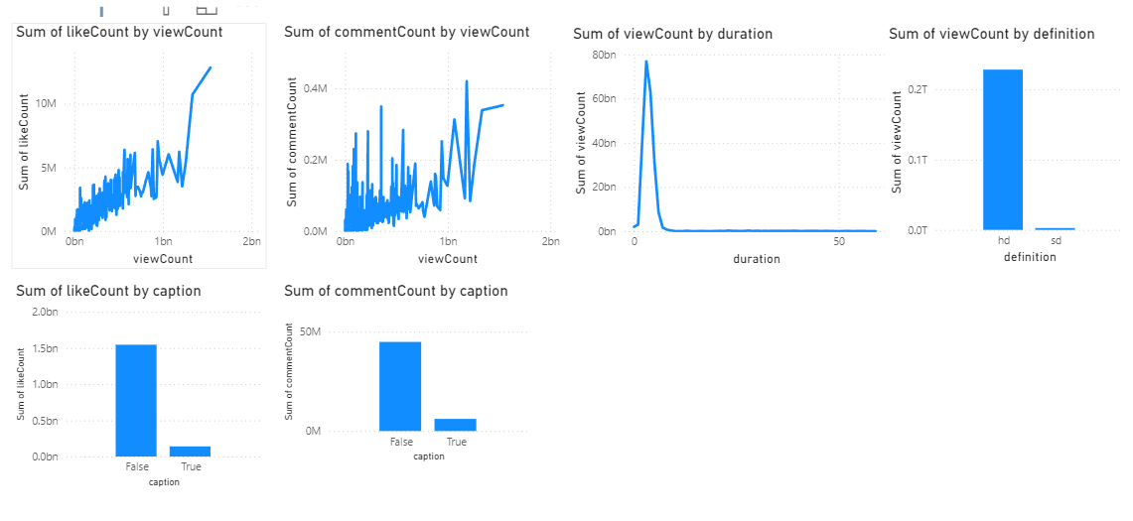
User Engagement Insights
We can see here that the likes have higher increase with view counts than comments
The best video duration to get maximum views is 3 minutes
HD quality has a correlation with views
Captions do not have a huge effect on views

Slide 11
Recommendations

Slide 12
Recommendations
The best time to post videos is on the second quarter of the year
HD videos have much higher view rate
Captions do not affect views
Comment numbers are always much lower than views and likes so to increase them the creator can interact with the viewers in the comments and show that they have an effect on future videos
The best video duration is 3 minutes for maximum engagement

Slide 13
Thank you

